Slide 1


Mo Tari
May 2024

Slide 2

Outline
Executive Summary
Introduction
Methodology
Results
Conclusion
Appendix

Slide 3
Executive Summary
Methodologies:
Data Collection through API and Web scraping
Data Wrangling
Exploratory Data Analysis (EDA) with SQL and Data Visualisation
Dashboard with Folium and Plotly
Predictive Analysis with Machine Learning
Results:
EDA Result
Interactive Analytics in Screenshots
Predictive Analytics

Slide 4
Introduction
Project Background:
SpaceX has entered the commercial space race with a mission to make rocket launches more affordable for everyone. By advertising its Eagle rocket launches at significantly lower prices, SpaceX aims to be a formidable competitor in the market. Much of the cost reduction is achieved by reusing the first stage of the rocket, a strategy that not only saves millions per launch but also showcases our innovative approach to sustainable space exploration.
Our commitment extends beyond cost savings. By deploying advanced data science and machine learning techniques, SpaceX is poised to predict the landing outcomes of both our and our competitors' rockets. This capability not only enhances our operational decisions but also allows us to accurately forecast the financial aspects of each launch.
The primary goals of our project include:
1. Identifying the key factors that contribute to the successful landing of a rocket.
2. Understanding the interactions between these factors to optimize the success rates of our landings.
3. Establishing the necessary operational conditions that underpin a successful and sustainable rocket landing program.

Slide 5

Section 1

Slide 6
Methodology
Executive Summary
Data collection methodology:
Data collection was performed using the SpaceX API and we scraping from Wikipedia.
Perform data wrangling
The collected data, which consists of JSON objects and HTML tables, is subsequently converted into a Pandas dataframe for analysis and visualisation.
Perform exploratory data analysis (EDA) using visualization and SQL
Perform interactive visual analytics using Folium and Plotly Dash
Perform predictive analysis using classification models
Machine learning is employed to predict the successful landing of Falcon 9's first stage.

Slide 7
Data Collection
Access SpaceX REST API Endpoint
Use Requests Library for API Call
Extract Key Data
Retrieve Past Launch Data as JSON
Convert JSON to DataFrame
Filter for Falcon 9 Launches
Handle Missing Data
Data Wrangling
Github - Data Collection Link

Slide 8
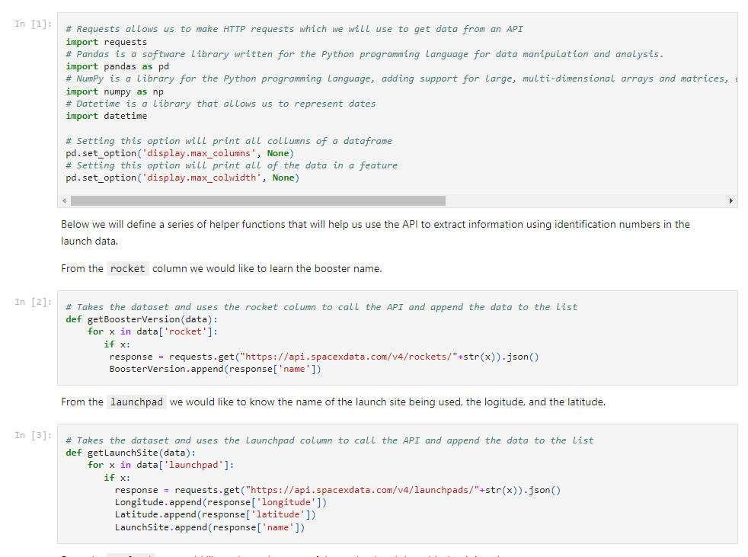
Data Collection – SpaceX API
The flowchart is presented in the previous slide and below is the Github link. Get request is used to gather data from SpaceX REST API
Place your flowchart of SpaceX API calls here
Github - Data Collection Link

Slide 9
Data Collection - Scraping
Access the Falcon 9 Launch Wikipedia Page
Parse Webpage with BeautifulSoup
Extract Column Headers from HTML Table
Construct DataFrame from HTML Table Data
Perform Data Wrangling
Github - Data Scraping Link

Slide 10
Data Wrangling
Identify Missing Data
Classify Data Types
Tally Launches by Site
Analyse Mission Outcomes by Orbit
Generate Outcome Labels for Landing
Prepare Data Wrangling Notebook
Github - Data Wrangling Link

Slide 11
EDA with Data Visualization
The summary of charts:
Catplot: illustrating the relationship between Flight Number and Payload.
Catplot: showing the correlation between Flight Number and Launch Site.
Catplot: detailing the connection between Payload and Launch Site.
Bar Chart: to depict the success rates across different Orbit types.
Catplot: to explore the relationship between Flight Number and Orbit type.
Catplot: to examine the association between Payload and Orbit type.
A line chart to display the trends in launch success over the years.
Github - EDA with Visualisation

Slide 12
EDA with SQL
Display the names of the unique launch sites in the space mission: select distinct "Launch_Site" from SPACEXTBL
Display 5 records where launch sites begin with the string 'CCA’ : select "Launch_Site" from SPACEXTBL where "Launch_Site" like "CCA%" limit 5
Display the total payload mass carried by boosters launched by NASA (CRS): select "Customer", SUM("PAYLOAD_MASS__KG_") AS "Total Mass KG" from SPACEXTBL where "Customer"="NASA (CRS)“
Display average payload mass carried by booster version F9 v1.1: select "Booster_Version", AVG("PAYLOAD_MASS__KG_") AS "Average Mass KG" from SPACEXTBL where "Booster_Version"="F9 v1.1“
List the date when the first succesful landing outcome in ground pad was achieved: select "Date" from SPACEXTBL where "Landing_Outcome"="Success (ground pad)“
List the names of the boosters which have success in drone ship and have payload mass greater than 4000 but less than 6000: select "Booster_Version" from SPACEXTBL where "Landing_Outcome"="Success (drone ship)" and "PAYLOAD_MASS__KG_" between 4000 and 6000
List the total number of successful and failure mission outcomes: SELECT SUM(CASE WHEN Mission_Outcome IN ('Success', 'Success (payload status unclear)') THEN 1 ELSE 0 END) AS Success_Mission,SUM(CASE WHEN Mission_Outcome = 'Failure (in flight)' THEN 1 ELSE 0 END) AS Failure_Mission FROM SPACEXTBL
List the names of the booster_versions which have carried the maximum payload mass. Use a subquery: select "Booster_Version", "PAYLOAD_MASS__KG_" from SPACEXTBL where PAYLOAD_MASS__KG_= (select max("PAYLOAD_MASS__KG_") from SPACEXTBL)
List the records which will display the month names, failure landing_outcomes in drone ship ,booster versions, launch_site for the months in year 2015: SELECT landing_outcome, booster_version, launch_site, DATE FROM SPACEXTBL WHERE landing_outcome LIKE '%Failure (drone ship)%' AND (DATE LIKE '2015%’)
Rank the count of landing outcomes (such as Failure (drone ship) or Success (ground pad)) between the date 2010-06-04 and 2017-03-20, in descending order: SELECT landing_outcome, COUNT(landing_outcome) AS Total FROM SPACEXTBL WHERE DATE BETWEEN '2010-06-04' AND '2017-03-20' GROUP BY landing_outcome ORDER BY Total DESC
Github - EDA with SQL

Slide 13
Build an Interactive Map with Folium
Summary of the map objects:
folium.Circle and folium.Marker: Highlight an area with a circle and a label at the specified location for each launch site on the map.
MarkerCluster: Simplifies the map by grouping markers that share the same location.
MousePosition: Lets you see the coordinates of where the mouse pointer is on the map.
folium.PolyLine: Draws a line from a launch site to the nearest city, railway, and highway.
Github - Site Location Analysis with Folium

Slide 14
Build a Dashboard with Plotly Dash
Summary of plots and interactions:
Launch Site Drop-down Menu: Choose from four launch sites via a drop-down menu.
Success Pie Chart Callback: Generates a pie chart to show launch success counts based on the selected launch site.
Range Slider to Select Payload: Adjust the slider to select different payload ranges and identify patterns visually.
Success Payload Scatter Plot Callback: Create a scatter plot to explore how payload correlates with mission outcomes.
Github - Site Dashboard with Plotly Dash

Slide 15
Predictive Analysis (Classification)
Data Load: Import dataset_part_2.csv and dataset_part_3.csv
Extract Variables: From dataset_part_2.csv, extract the "Class" column to create variable Y
From dataset_part_3.csv, use the features_one_hot dataframe to create variable X
Model Creation: Develop Logistic Regression, Support Vector Machine (SVM), Decision Tree, k-Nearest Neighbors (KNN), and GridSearchCV objects
Evaluate Performance: Identify the best parameters, assess accuracy, and generate a confusion matrix
Select Best Method: Choose the method that performs best
Split Data: Use train_test_split to divide the data into training and testing sets

Slide 16
Results
Exploratory data analysis results
Interactive analytics demo in screenshots
Predictive analysis results

Slide 17

Section 2

Slide 18
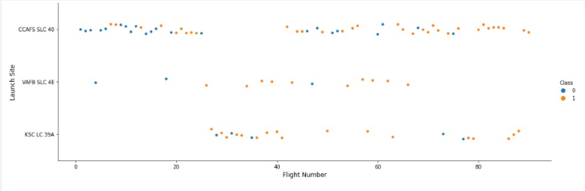
Flight Number vs. Launch Site
Increased Success Rate: Over time, the success rate has improved at every launch site, especially at CCAFS SLC 40, which hosts the majority of the launches.
Higher Success Rate at VAFB and KSC: VAFB SLC 4E and KSC LC 39A have higher success rates but collectively represent only one-third of the total launches.

Slide 19
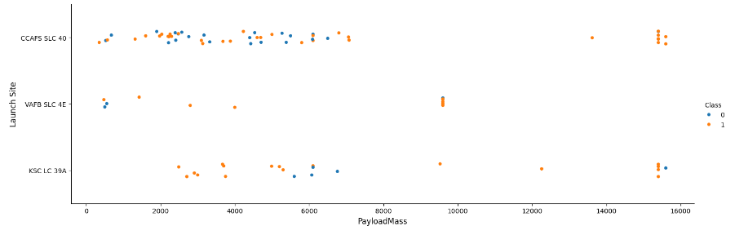
Payload vs. Launch Site
VAFB-SLC: The VAFB-SLC launch site doesn't conduct launches for rockets with heavy payloads (greater than 10,000 kg).
KSC LC: The KSC LC launch site doesn't conduct launches for rockets with lower payloads (less than 2,500 kg).
CCAFS SLC: The CCAFS SLC launch site only launches rockets with payloads below 7,500 kg or above 13,000 kg, with no launches in between.

Slide 20
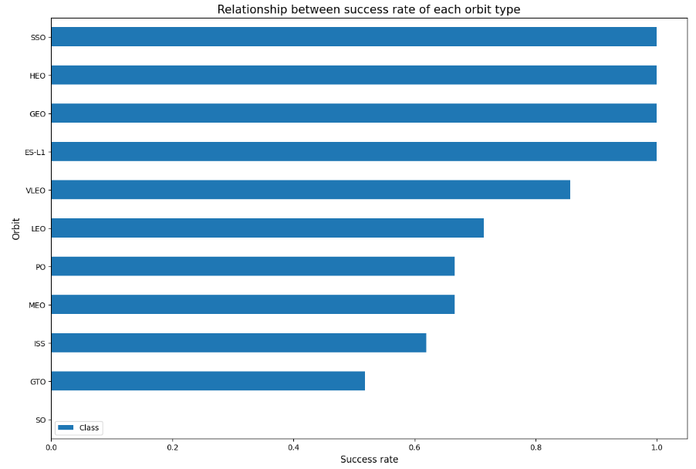
Success Rate vs. Orbit Type
Bar Chart Interpretation: The bar chart should be understood in terms of the number of launches per orbit type.
First Four Orbit Types: The initial four orbit types show the highest success rates.

Slide 21
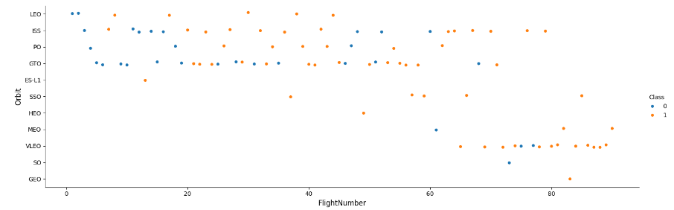
Flight Number vs. Orbit Type
Improved Success Rate Over Time: The success rate has steadily increased for all launch sites. This is especially evident for CCAFS SLC 40, which accounts for the majority of launches.
Higher Success Rate at VAFB and KSC: The VAFB SLC 4E and KSC LC 39A launch sites have higher success rates, representing one-third of the total launches.

Slide 22
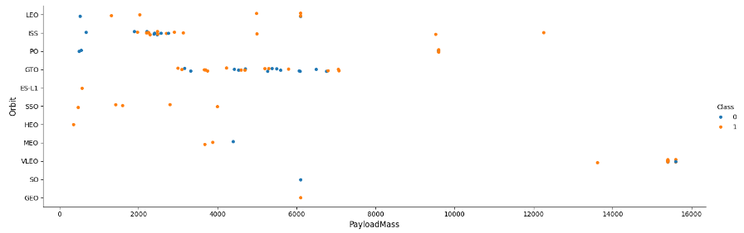
Payload vs. Orbit Type
Payload Limit: There is a noticeable payload limit of around 7,600 kg. Less than ten launches exceed this threshold.
Higher Landing Success for Certain Orbits: For heavier payloads, the landing success rates are higher in the Polar, Low Earth Orbit (LEO), and International Space Station (ISS) orbits.
Unclear Success in GTO: In the Geostationary Transfer Orbit (GTO), it's harder to distinguish success rates because both positive and negative landing outcomes occur frequently.

Slide 23
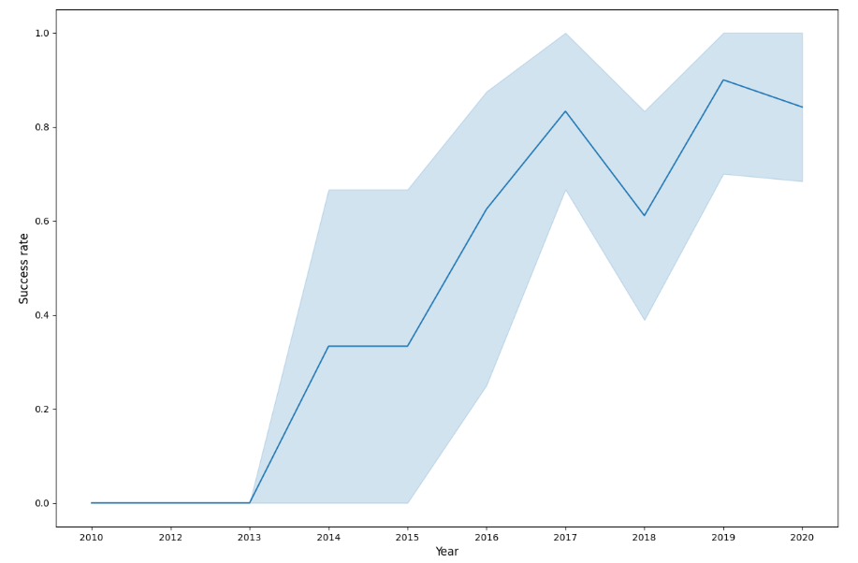
Launch Success Yearly Trend
Improved Success Rate: The success rate has shown a consistent upward trend from 2013 to 2020.

Slide 24
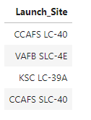
All Launch Site Names
List of Four Launch Sites: The following four launch sites were identified using the SQL DISTINCT function.

Slide 25
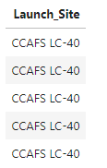
Launch Site Names Begin with 'CCA'
List of Five Records Begin with ‘CCA’: The following five records were identified using the SQL LIKE function.

Slide 26
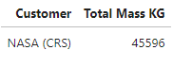
Total Payload Mass
Total Payload Mass by NASA: The following figure is the total payload mass carried by boosters launched by NASA (CRS) using SQL SUM

Slide 27
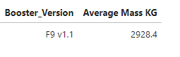
Average Payload Mass by F9 v1.1
Average Payload Mass: The following figure is the average payload mass carried by booster version F9 v1.1 using SQL AVG function.

Slide 28

First Successful Ground Landing Date
First Success Date: The following date is the first successful landing outcome using SQL MIN function.

Slide 29
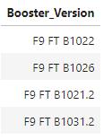
Successful Drone Ship Landing with Payload between 4000 and 6000
Name of Boosters: The following is the list of boosters which have successfully landed on drone ship and had payload mass greater than 4000 but less than 6000

Slide 30
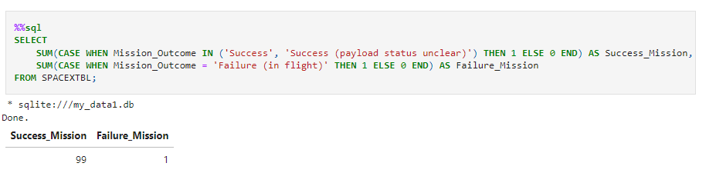
Total Number of Successful and Failure Mission Outcomes
Total Successful and Failure Outcomes: The following code used to get the total number of successful and failure mission outcomes.

Slide 31
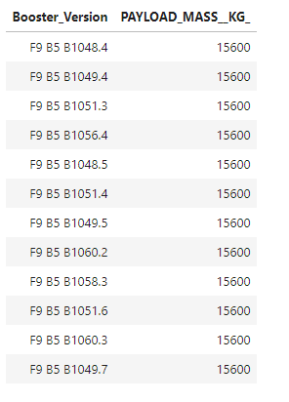
Boosters Carried Maximum Payload
List of Boosters Carried the Max Payload: The following list is the name of the boosters which carried the maximum payload mass using SUBQUERY.

Slide 32
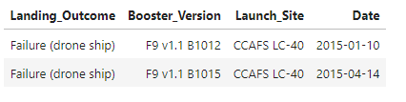
2015 Launch Records
List of Failed Landing Outcomes: The following list is the failed landing_outcomes in drone ship, their booster versions, and launch site names for in year 2015

Slide 33
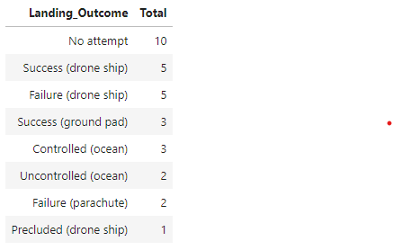
Rank Landing Outcomes Between 2010-06-04 and 2017-03-20
Landing Outcome Ranking: The following list is the count of landing outcomes between the date 2010-06-04 and 2017-03-20

Slide 34

Section 3

Slide 35
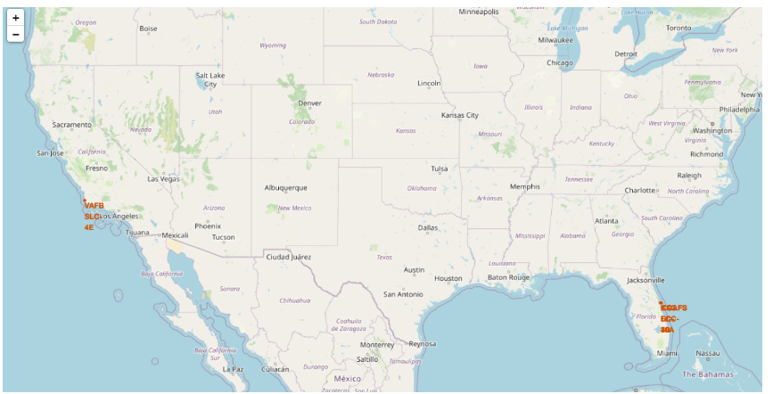
All Launch Sites Marked on Map

Slide 36
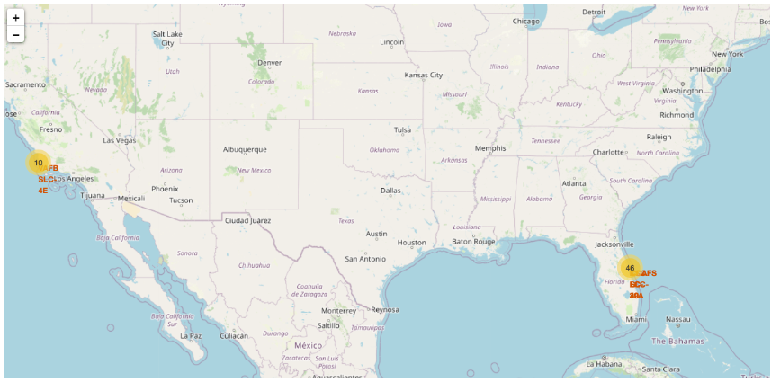
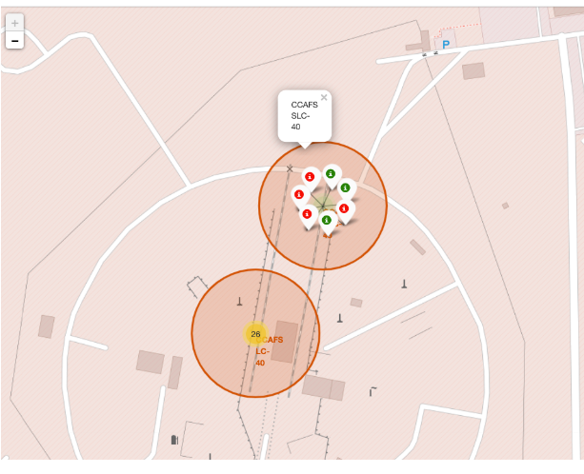
Success or Failed Launches For Each Site
The left map illustrates clusters for each launch site. The righ map displays a green marker for successful launches and a red marker for failed launches.

Slide 37
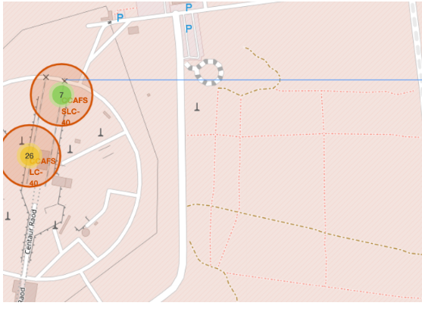
Distance Calculation
The launch sites are place in remote places for safety.

Slide 38

Section 4

Slide 39
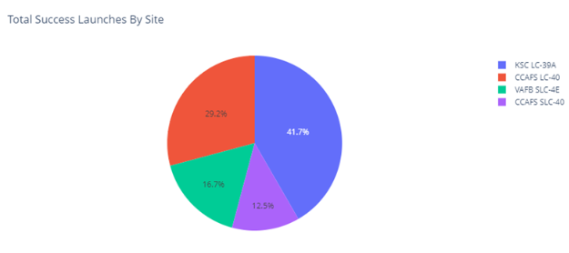
Success Launches by Sites
KSC LC-39A has the highest number of successful launched, while CCAFS SLC-40 has the lowest.

Slide 40
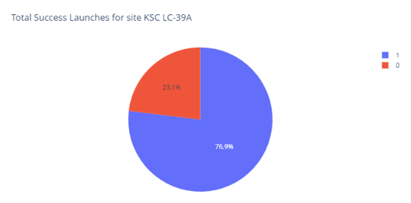
KSC LC-39A
The pie chart for the launch site KSC LC-39A indicates that this site has the highest launch success ratio.

Slide 41
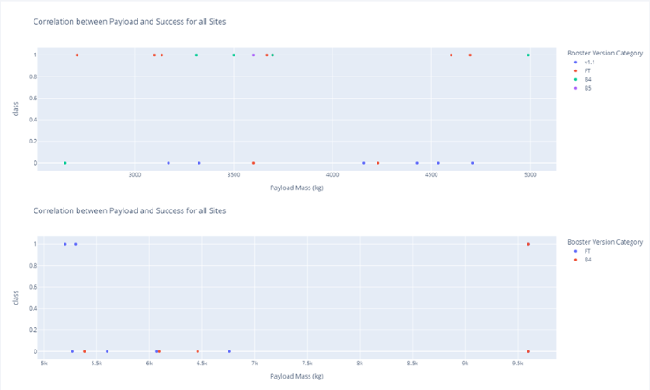
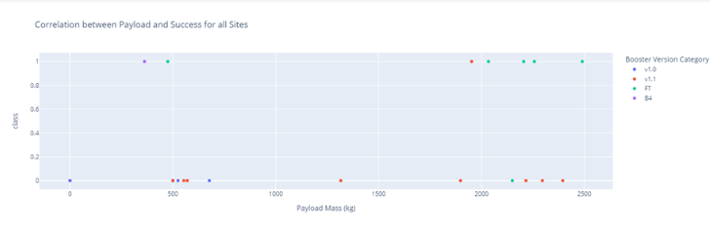
Payload vs. Launch Outcome
The scatter plot includes data for all sites with payload ranges of 2500 kg, 5000 kg, and 10,000 kg. The 2500–5000 kg range accounts for the majority of successful launches, while the 0–2500 kg range has the most failed launches. However, all three ranges are similar.

Slide 42

Section 5

Slide 43
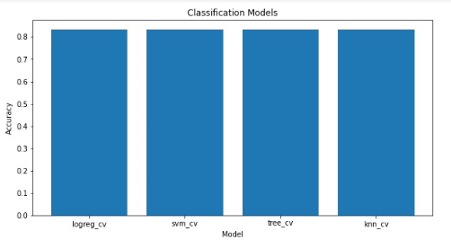
Classification Accuracy
All models have the same accuracy.

Slide 44
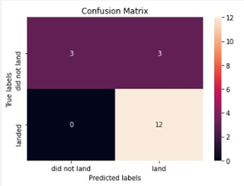
Confusion Matrix
Similar to the previous slide, the confusion matrix is the same for all models.

Slide 45
Conclusions
Since all the algorithms yield comparable accuracy, their performance is nearly identical.
By utilizing our machine learning model, we can forecast whether the first stage of our competitor's launch will land and estimate the launch cost.

Slide 46
Appendix
For Python code snippets, SQL queries, charts, Notebook outputs, or data sets click on the following link:
Github - Winning Space Race

Slide 47


